Slide 1


Quantitative Methods for Finance
Hu Chunguo 7286005
Fang Xiaoyuan7299351
BU Tian 7258292
Hu Jinbo 7262750
Chen Daoxu 7216153
DU Huaxin 7258101

Slide 2
CONTENTS
Data source
Data analysis
Influencing factors

Slide 3
01
PART 01
Data source

Slide 4
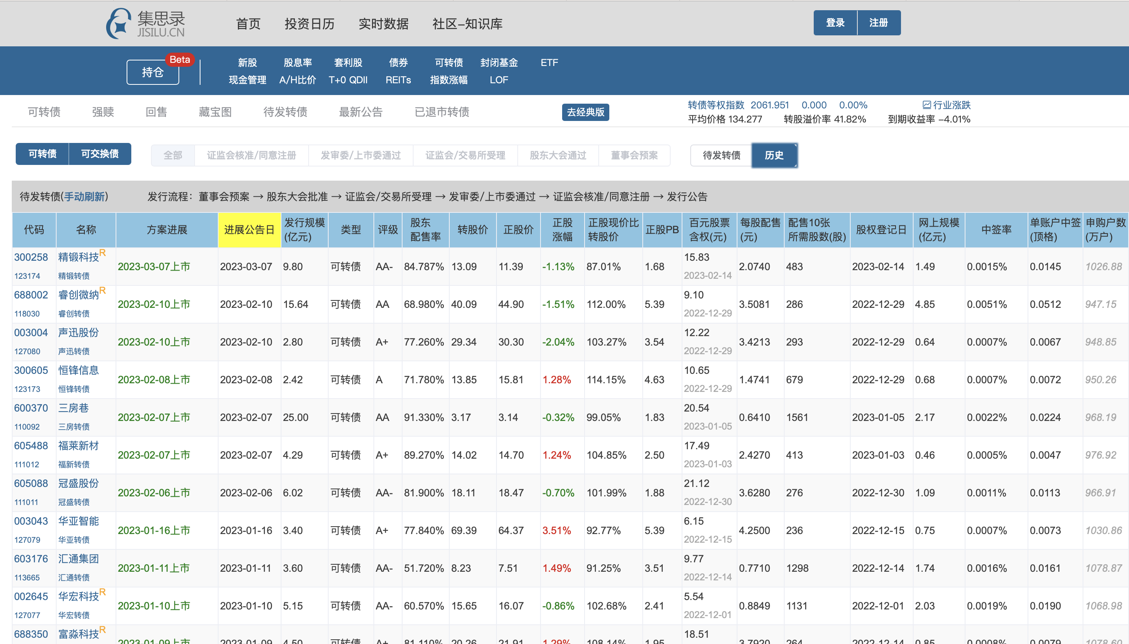
集思录——https://www.jisilu.cn/web/data/cb/pre

Slide 5
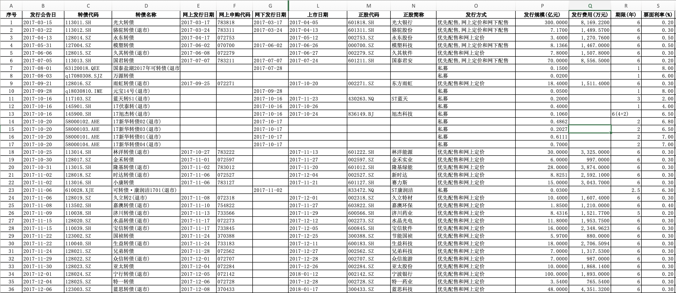
Wind——Issue Information

Slide 6
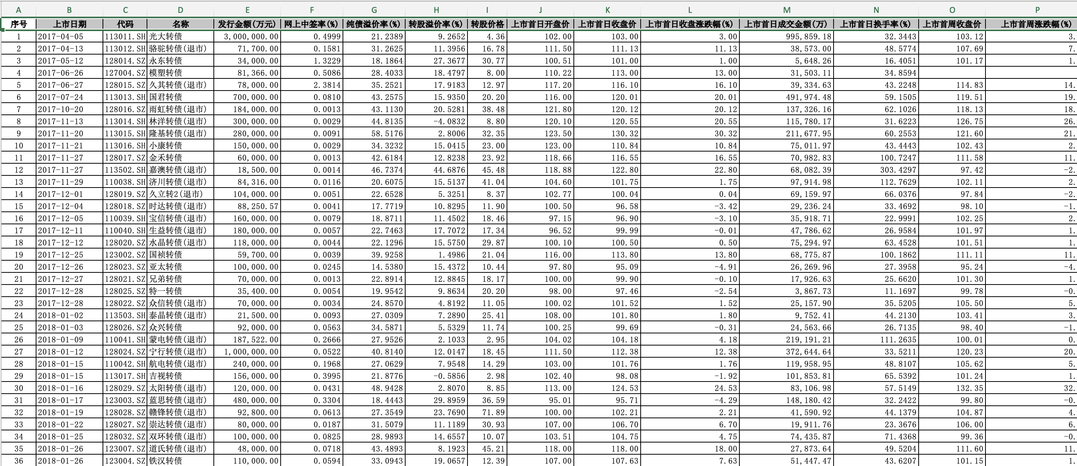
Wind——Issue Performance

Slide 7
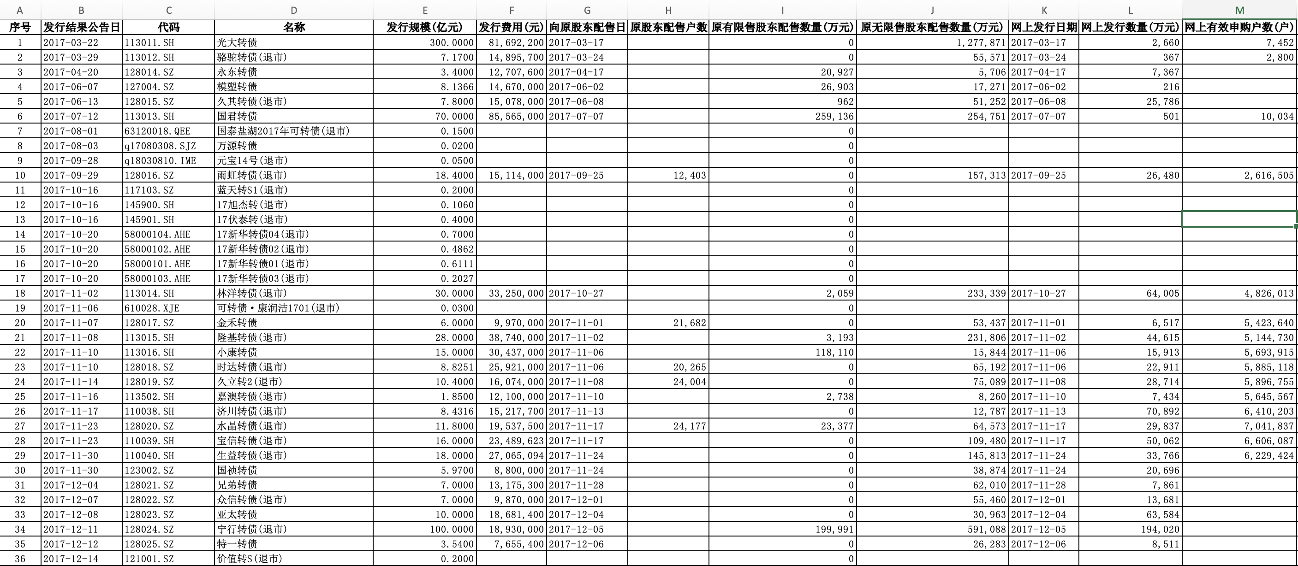
Wind——Issue Results

Slide 8
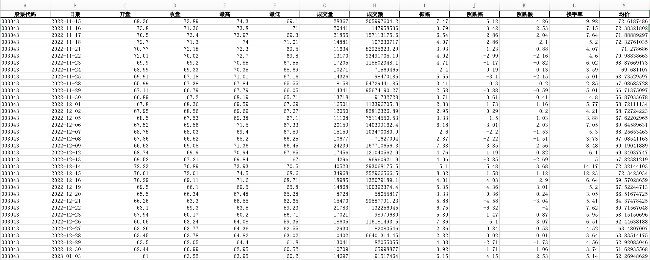
Akshare——Stock Price

Slide 9
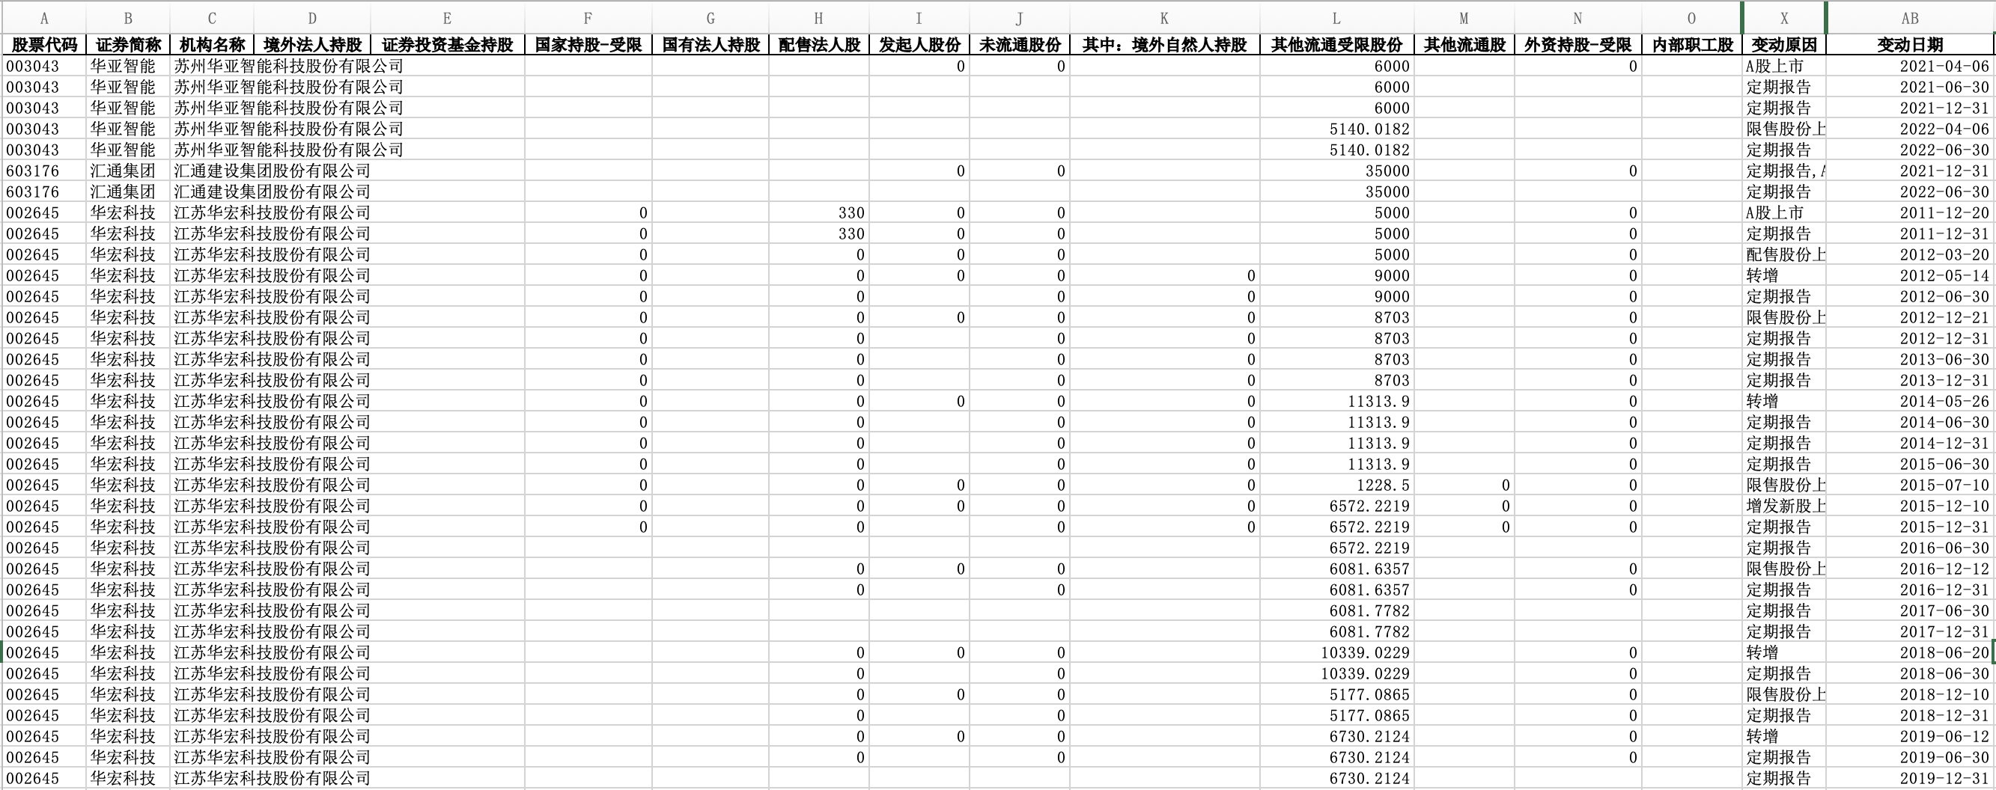
Akshare——Total Number of Shares

Slide 10
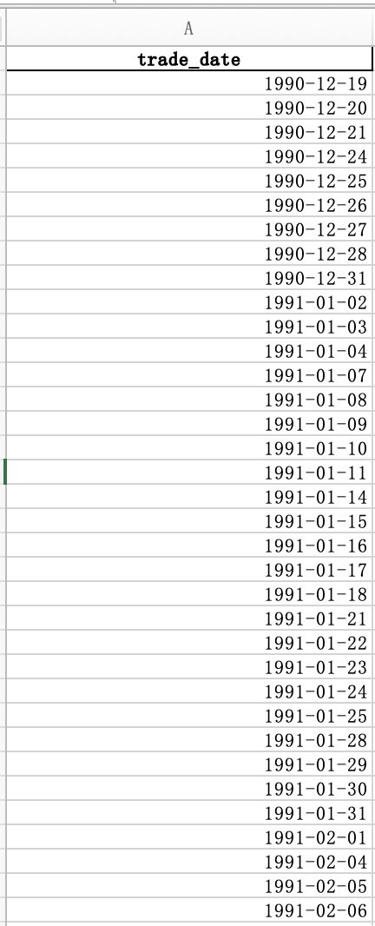
Akshare——Trade Date
If we know T date, how to Calculate the T-1 date, T-2 date?

Slide 11
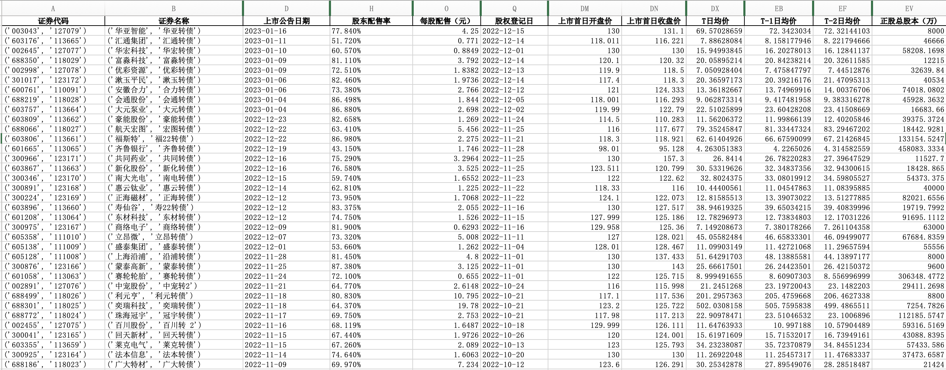
Merge the tables

Slide 12
02
PART 02
Data analysis

Slide 13
General View
We analyzed the issuance of convertible bonds from 2019 to November 18, 2022.
A total of 558 convertible bonds were issued, with an average annual issuance of about 250 billion yuan

Slide 14
General View
The return of the convertible bond increases year by year, but the loss of the stock is also expanding, resulting in the decline of the net income

Slide 15
Convertible Bond Performance
Almost all are profitable, up to 19.82% on average

Slide 16
According to statistics, in the past four years, the overall increase in share price on day T-2 is the most significant. Although the share price on day T-1 is also on an upward trend, the magnitude is much lower than on day T-2, and the share price starts to fall on day T.
Price volatility of the underlying shares
涨跌幅 | T-3日 | T-2日 | T-1日 | T日
整体 | 0.53% | 0.24% | -1.60% | -1.60%
2019 | 0.56% | 1.40% | 0.50% | -0.23%
2020 | 0.49% | 1.97% | 0.37% | -1.72%
2021 | 0.50% | 2.13% | -0.14% | -1.20%
2022 | 0.58% | 1.78% | 0.19% | -2.95%
The reason for the insignificant increase on T-2 is that people have already started to seize right on T-2. On T-2, the stock price has risen significantly due to seizing right, and on T day people began to sell the funds for grabbing power, which led to the stock price on T day fell sharply. So we can buy the stock on T-2.

Slide 17
The share price volatility of the underlying share price can increase the uncertainty of the seizing right strategy
Price volatility of the underlying shares
涨跌幅 | T-3日 | T-2日 | T-1日 | T日
整体 | 0.53% | 0.24% | -1.60% | -1.60%
2019 | 0.56% | 1.40% | 0.50% | -0.23%
2020 | 0.49% | 1.97% | 0.37% | -1.72%
2021 | 0.50% | 2.13% | -0.14% | -1.20%
2022 | 0.58% | 1.78% | 0.19% | -2.95%
In the seizing right strategy, the occupation of funds is only for 3 trading days, and the bid-ask price difference between T-2 day and T-day is equivalent to the cost paid for obtaining the priority placement right.

Slide 18
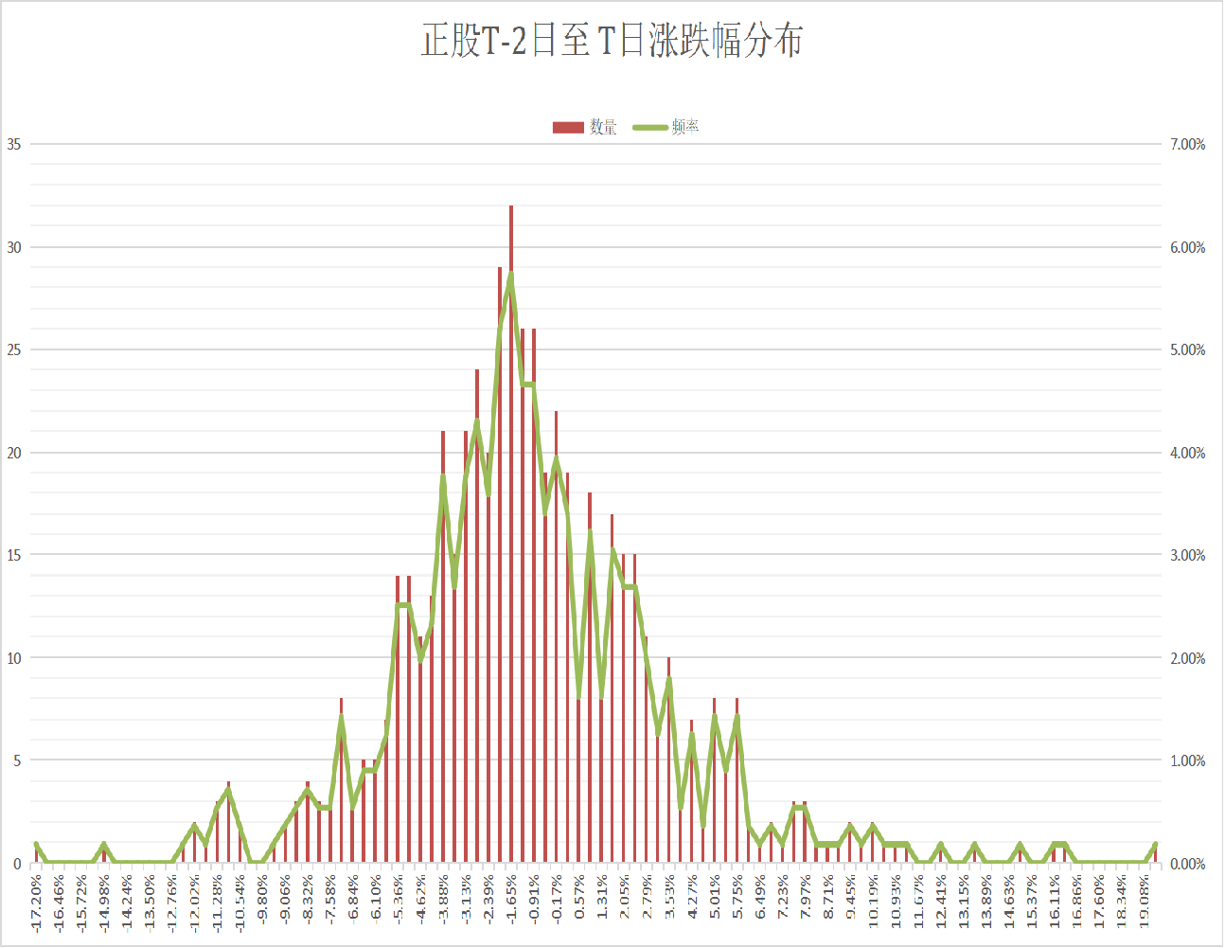
Stock Performance
Maximum value = 19.08%
Minimum value = -17.2%
Mean value = -1.21%
the share price rose by a maximum of 19.08%，We can profit at most and stock maximum loss at 17.2%
The average value of the rise and fall of the positive shares is -1.21%, indicating that the cost of grabbing the right has an average loss of -1.21%

Slide 19
03
PART 03
Influencing factors

Slide 20
Stock Market Value
正股市值 | T-2日至T日 | T日 | 转债盈亏 | 正股盈亏 | 总收益
小于50亿 | -1.45% | -2.14% | 186.59 | -115.93 | 70.66
50-100亿 | -1.30% | -1.55% | 181.37 | -81.67 | 99.70
100-500亿 | -1.02% | -1.29% | 217.11 | -114.84 | 102.27
500亿以上 | -0.81% | -1.09% | 245.51 | -124.19 | 121.32
As we can see, the different company with different market value can exhibit totally different stock price. Thus, we want to find out how exactly the market value can influence the CB profit and the average fluctuation. We sort the market value into different range, which is set from less than 50 million yuan to more than 500 million yuan. And the result shows that the less value the company owns, the less stock price and profits the investors can earn. this can give us a lesson that investors should choose the CB issued by company owns higher market value.

Slide 21
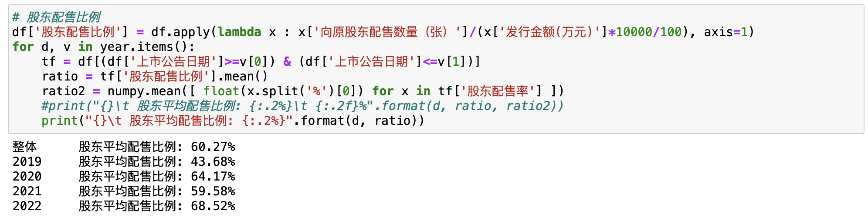
Shareholders’ allotment ratio
The shareholders’ allotment ratio refers to the exact numbers of convertible bond the original shareholders can own after the issuance of the convertible bond. The formula to calculate this ratio is that the numbers of CB owned by the original shareholders dividend by the total CB issuance numbers. What’s more, we find out that the exact ratio of CB can be sorted out by python from 2019 to 2022,which is shown as below:

Slide 22
Shareholders’ allotment ratio
股东配售比例 | T-2日至T日 | T日 | 转债盈亏 | 正股盈亏 | 总收益 | 数量
小于40% | -0.84% | -1.06% | 120 | -126.33 | -6.33 | 118
40%-50% | -0.67% | -0.87% | 151.2 | -7.11 | 144.09 | 44
50%-60% | -1.52% | -1.86% | 173.9 | -102.63 | 71.27 | 63
60%-70% | -1.87% | -2.13% | 246.16 | -237.1 | 9.05 | 105
70%-80% | -0.99% | -1.65% | 233.63 | -78.71 | 154.92 | 119
80%-90% | -1.18% | -1.80% | 240.54 | -35.43 | 205.12 | 92
90%以上 | -1.52% | -1.61% | 276.27 | -46.33 | 229.95 | 17
we can tell that the shareholder’s allotment ratio can also offer a positive impact on the profits of CB. We manipulate python to get the result turning out that the more the allotment ratio, the more profits the CB investors can get. The below chart can exactly explain the assumption.

Slide 23
Stock price fluctuation during T-3 to T-5
T-3至T-5日 | T-2至T日 | T日 | 转债盈亏 | 正股盈亏 | 总盈亏 | 数量
大于10% | -1.62% | -0.75% | 117.4 | -127.1 | -9.65 | 12
5%至10% | -1.19% | -1.09% | 198.8 | -174.6 | 24.2 | 46
0%至5% | -1.65% | -2.01% | 208 | -164.1 | 43.97 | 245
-5%至0% | -1.13% | -1.33% | 186.2 | -88.24 | 97.95 | 216
-10%至-5% | 1.49% | -1.19% | 296.2 | 277.1 | 573.3 | 31
小于-10% | 0.31% | -2.30% | 165.6 | 28.06 | 193.7 | 8
According to the output results, there was no obvious correlation between the increase of stocks from T-3 day to T-5 day and the increase of stocks from T-2 day to T day . Only a handful of stocks that performed poorly (losses greater than 5 per cent) between T-3 day and T-5 day showed any gains between T-2 day and T day.

Slide 24
Stock price fluctuation during T-3 to T-5
T-3至T-5日 | T-2至T日 | T日 | 转债盈亏 | 正股盈亏 | 总盈亏 | 数量
大于10% | -1.62% | -0.75% | 117.4 | -127.1 | -9.65 | 12
5%至10% | -1.19% | -1.09% | 198.8 | -174.6 | 24.2 | 46
0%至5% | -1.65% | -2.01% | 208 | -164.1 | 43.97 | 245
-5%至0% | -1.13% | -1.33% | 186.2 | -88.24 | 97.95 | 216
-10%至-5% | 1.49% | -1.19% | 296.2 | 277.1 | 573.3 | 31
小于-10% | 0.31% | -2.30% | 165.6 | 28.06 | 193.7 | 8
Due to the large increase in stocks, investors concentrated selling in large quantities, forming selling pressure. As a result, the average price from T-2 to T-day has a large drop.
If the stock has a large drop in the early stage, investors will not choose to sell a large number of stocks, so the average price from T-2 to T-day may generate positive returns.

Slide 25
Margin of Safety
Margin of safety is a principle of investing in which an investor only purchases securities when their market price is significantly below their intrinsic value. In other words, when the market price of a security is significantly below your estimation of its intrinsic value, the difference is the margin of safety. Because investors may set a margin of safety in accordance with their own risk preferences, buying securities when this difference is present allows an investment to be made with minimal downside risk.

Slide 26
Margin of Safety
安全边际 | T-2至T日 | T日 | 转债盈亏 | 正股盈亏 | 总盈亏 | 数量
1%以下 | -0.12% | -0.41% | 291.68 | -24.21 | 267.47 | 110
1-2% | -1.24% | -1.72% | 219.07 | -159.7 | 59.4 | 191
2-3% | -1.36% | -1.60% | 163.98 | -116.2 | 47.8 | 139
3-4% | -0.89% | -1.62% | 144.96 | -56.07 | 88.89 | 64
4-5% | -3.81% | -3.54% | 130.68 | -177.5 | -46.79 | 23
大于5% | -2.95% | -3.72% | 104.5 | -97.27 | 7.23 | 31
According to the output results, there was no obvious positive correlation between the yield of convertible bonds and the margin of safety. Low or even negative total profit and loss occurred in some objects with high safety margin (greater than 4%). It may be because convertible bonds with a higher margin of safety are more vulnerable to liquidity shocks and investors are more willing to sell them on T-day.

Slide 27
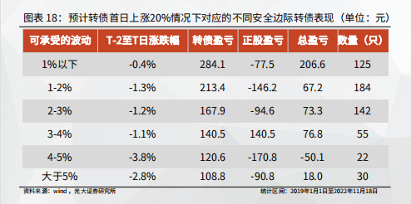
Difference
安全边际 | T-2至T日 | T日 | 转债盈亏 | 正股盈亏 | 总盈亏 | 数量
1%以下 | -0.12% | -0.41% | 291.68 | -24.21 | 267.47 | 110
1-2% | -1.24% | -1.72% | 219.07 | -159.7 | 59.4 | 191
2-3% | -1.36% | -1.60% | 163.98 | -116.2 | 47.8 | 139
3-4% | -0.89% | -1.62% | 144.96 | -56.07 | 88.89 | 64
4-5% | -3.81% | -3.54% | 130.68 | -177.5 | -46.79 | 23
大于5% | -2.95% | -3.72% | 104.5 | -97.27 | 7.23 | 31
When our team calculated the margin of safety through python, the results we got were different from those published by Everbright Securities. Of all the items we looked at, this was the only one where there was a discrepancy. We found that the number of our statistics and Everbright securities statistics are inconsistent and we haven't found the cause.

Slide 28
04
PART 04
Summary and Outlook

Slide 29
Summary
证券代码 | 证券名称 | 转债盈亏 | 正股盈亏 | 总盈亏 | 股东配售比例 | 正股市值 | T-3日至T-5日股价涨跌幅 | 安全边际 | 正股T-2日至T日涨跌幅 | 可转债上市当天涨跌幅
('603608', '113589') | ('天创时尚', '天创转债') | 57.15 | -1696.63 | -1639.48 | 52.56% | 58.19 | 6.50% | 3.04% | -17.20% | 5.71%
('002503', '128100') | ('搜于特', '搜特转债') | 79.01 | -2928.93 | -2849.92 | 9.33% | 172.25 | 14.08% | 1.55% | -15.16% | 7.90%
('002921', '128120') | ('联诚精密', '联诚转债') | 90.90 | -990.46 | -899.56 | 69.81% | 20.30 | 10.32% | 3.85% | -12.72% | 9.09%
('688676', '118019') | ('金盘科技', '金盘转债') | 326.98 | -1795.36 | -1468.38 | 67.46% | 147.29 | -2.31% | 2.04% | -12.22% | 32.70%
('688096', '118016') | ('京源环保', '京源转债') | 256.51 | -573.46 | -316.94 | 70.45% | 14.95 | -4.35% | 6.36% | -12.16% | 25.65%
('002988', '127053') | ('豪美新材', '豪美转债') | 176.30 | -722.78 | -546.48 | 79.79% | 51.16 | 1.39% | 4.98% | -11.99% | 17.63%
('600496', '110086') | ('精工钢构', '精工转债') | 167.62 | -538.07 | -370.46 | 61.47% | 94.61 | -1.30% | 6.45% | -11.57% | 16.76%
('300305', '123144') | ('裕兴股份', '裕兴转债') | 55.65 | -760.05 | -704.40 | 61.33% | 39.56 | -1.74% | 4.56% | -11.56% | 5.56%
('300818', '123127') | ('耐普矿机', '耐普转债') | 233.41 | -713.75 | -480.35 | 22.78% | 25.27 | 0.61% | 4.81% | -11.44% | 23.34%
('603609', '113647') | ('禾丰股份', '禾丰转债') | 155.49 | -683.28 | -527.79 | 71.20% | 94.13 | 9.99% | 4.94% | -11.26% | 15.55%
('300778', '123136') | ('新城市', '城市转债') | 252.67 | -684.63 | -431.96 | 89.38% | 26.81 | 2.12% | 4.93% | -11.24% | 25.27%
('300776', '123121') | ('帝尔激光', '帝尔转债') | 382.48 | -2755.24 | -2372.77 | 85.95% | 205.40 | 6.40% | 1.22% | -11.24% | 38.25%
('000589', '127063') | ('贵州轮胎', '贵轮转债') | 137.24 | -328.36 | -191.12 | 61.26% | 53.36 | 1.75% | 10.20% | -11.17% | 13.72%
('603499', '113566') | ('翔港科技', '翔港转债') | 371.38 | -1286.70 | -915.33 | 69.38% | 21.69 | -0.17% | 2.54% | -10.90% | 37.14%
('603136', '113564') | ('天目湖', '天目转债') | 226.73 | -1064.51 | -837.78 | 88.52% | 28.10 | -2.24% | 3.03% | -10.74% | 22.67%
('603535', '113656') | ('嘉诚国际', '嘉诚转债') | 128.39 | -614.39 | -486.00 | 83.52% | 36.02 | -0.83% | 4.61% | -9.45% | 12.84%
('605189', '111005') | ('富春染织', '富春转债') | 264.97 | -457.03 | -192.06 | 90.23% | 29.58 | 3.95% | 6.13% | -9.35% | 26.50%
('002931', '128143') | ('锋龙股份', '锋龙转债') | -4.93 | -883.49 | -888.42 | 80.17% | 24.73 | -3.83% | 3.15% | -9.28% | -0.49%
('688590', '118021') | ('新致软件', '新致转债') | 259.00 | -444.44 | -185.44 | 54.29% | 18.78 | 2.35% | 6.03% | -8.94% | 25.90%
('300057', '123085') | ('万顺新材', '万顺转2') | -79.32 | -411.63 | -490.94 | 66.94% | 42.02 | 1.85% | 6.51% | -8.93% | -7.93%
('603585', '113640') | ('苏利股份', '苏利转债') | 144.88 | -338.40 | -193.52 | 89.84% | 36.52 | 1.84% | 7.88% | -8.89% | 14.49%
('301002', '123159') | ('崧盛股份', '崧盛转债') | 222.92 | -812.24 | -589.32 | 64.59% | 28.88 | 0.03% | 3.16% | -8.57% | 22.29%
('600075', '110087') | ('新疆天业', '天业转债') | 179.52 | -333.44 | -153.92 | 75.62% | 116.95 | 0.43% | 7.67% | -8.53% | 17.95%
('601366', '113033') | ('利群股份', '利群转债') | 88.67 | -284.34 | -195.67 | 50.37% | 61.70 | 4.68% | 8.97% | -8.51% | 8.87%
('300607', '123101') | ('拓斯达', '拓斯转债') | 74.70 | -1351.55 | -1276.85 | 60.39% | 109.69 | -2.18% | 1.85% | -8.35% | 7.47%
('002557', '128135') | ('洽洽食品', '洽洽转债') | 192.20 | -2006.81 | -1814.61 | 68.49% | 305.42 | 2.13% | 1.23% | -8.25% | 19.22%
('300283', '123141') | ('温州宏丰', '宏丰转债') | 300.00 | -767.43 | -467.43 | 67.78% | 29.85 | 1.69% | 3.17% | -8.12% | 30.00%
('601108', '113043') | ('财通证券', '财通转债') | 115.81 | -1046.73 | -930.92 | 71.71% | 473.03 | -2.42% | 2.30% | -8.01% | 11.58%
('603901', '113654') | ('永创智能', '永02转债') | 215.70 | -873.50 | -657.81 | 72.20% | 68.97 | -0.39% | 2.67% | -7.77% | 21.57%
('000411', '127028') | ('英特集团', '英特转债') | -71.21 | -616.58 | -687.80 | 52.15% | 47.75 | -5.19% | 3.73% | -7.67% | -7.12%
('603363', '113620') | ('傲农生物', '傲农转债') | 49.59 | -732.60 | -683.01 | 63.86% | 96.79 | -3.14% | 3.11% | -7.60% | 4.96%
('300190', '123049') | ('维尔利', '维尔转债') | 140.88 | -490.52 | -349.64 | 52.20% | 59.49 | 4.57% | 4.56% | -7.45% | 14.09%
('600711', '110066') | ('盛屯矿业', '盛屯转债') | 83.13 | -361.63 | -278.50 | 33.54% | 112.17 | -1.37% | 6.12% | -7.37% | 8.31%
('688689', '118011') | ('银河微电', '银微转债') | 288.91 | -605.55 | -316.63 | 56.65% | 40.09 | 4.75% | 3.65% | -7.37% | 28.89%
('601677', '113025') | ('明泰铝业', '明泰转债') | -24.38 | -292.80 | -317.18 | 24.00% | 68.84 | 3.15% | 7.53% | -7.35% | -2.44%
('002775', '128127') | ('文科园林', '文科转债') | 54.50 | -226.94 | -172.44 | 77.78% | 29.74 | 2.27% | 9.69% | -7.33% | 5.45%
('601963', '113056') | ('重庆银行', '重银转债') | 50.03 | -100.76 | -50.73 | 73.56% | 329.73 | 8.74% | 21.69% | -7.28% | 5.00%
('002997', '127065') | ('瑞鹄模具', '瑞鹄转债') | 462.49 | -566.49 | -104.00 | 82.48% | 32.39 | 2.40% | 3.85% | -7.26% | 46.25%
('300243', '123126') | ('瑞丰高材', '瑞丰转债') | 100.87 | -911.11 | -810.23 | 63.67% | 40.91 | 6.67% | 2.39% | -7.25% | 10.09%
('300850', '123161') | ('新强联', '强联转债') | 252.15 | -1737.11 | -1484.95 | 64.92% | 291.79 | -1.03% | 1.24% | -7.18% | 25.22%
('600388', '110068') | ('ST龙净', '龙净转债') | 80.77 | -370.19 | -289.42 | 61.79% | 102.63 | -5.92% | 5.63% | -6.94% | 8.08%

Slide 30
Summary
相关系数 | 转债盈亏 | 正股盈亏 | 总盈亏 | 股东配售比例 | 正股市值 | T-3日至T-5日股价涨跌幅 | 安全边际 | 正股T-2日至T日涨跌幅 | 可转债上市当天涨跌幅
转债盈亏 | 1.00 | -0.01 | 0.23 | 0.28 | 0.07 | -0.05 | -0.29 | 0.07 | 1.00
正股盈亏 | -0.01 | 1.00 | 0.97 | 0.03 | 0.07 | -0.11 | -0.01 | 0.78 | -0.01
总盈亏 | 0.23 | 0.97 | 1.00 | 0.10 | 0.08 | -0.12 | -0.08 | 0.78 | 0.23
股东配售比例 | 0.28 | 0.03 | 0.10 | 1.00 | 0.09 | 0.06 | -0.16 | -0.03 | 0.28
正股市值 | 0.07 | 0.07 | 0.08 | 0.09 | 1.00 | 0.00 | -0.17 | 0.07 | 0.07
T-3日至T-5日股价涨跌幅 | -0.05 | -0.11 | -0.12 | 0.06 | 0.00 | 1.00 | 0.05 | -0.11 | -0.05
安全边际 | -0.29 | -0.01 | -0.08 | -0.16 | -0.17 | 0.05 | 1.00 | -0.15 | -0.29
正股T-2日至T日涨跌幅 | 0.07 | 0.78 | 0.78 | -0.03 | 0.07 | -0.11 | -0.15 | 1.00 | 0.07
可转债上市当天涨跌幅 | 1.00 | -0.01 | 0.23 | 0.28 | 0.07 | -0.05 | -0.29 | 0.07 | 1.00

